Slide 1
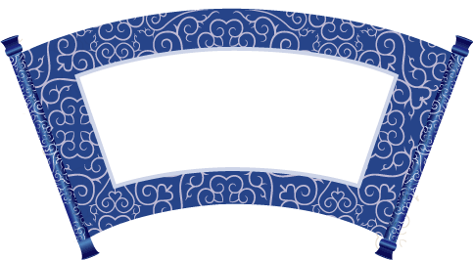
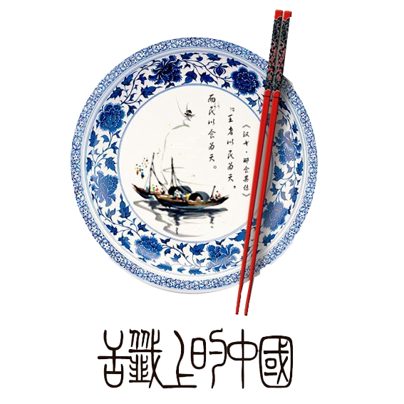


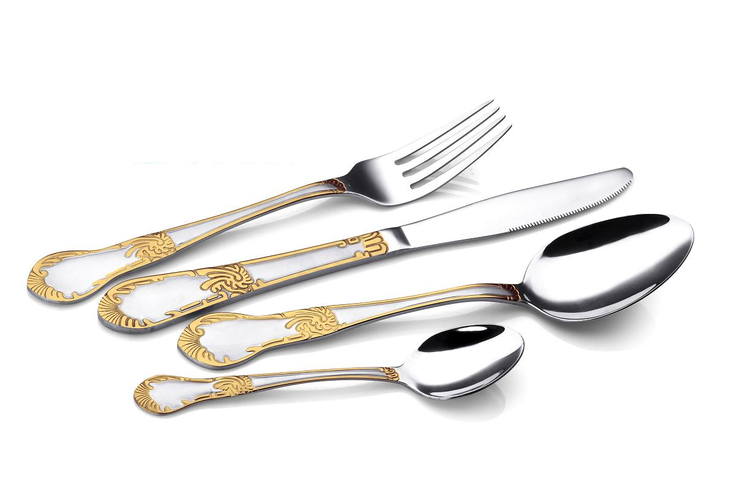
Difference between Chinese dinging manners and Western's

Slide 2

01
Reason
Contents
02
Basic Rule
03
The Setting
04
Drinking Etiquette
05
Dining table wares
06
Order of dishes and interesting manners

Slide 3

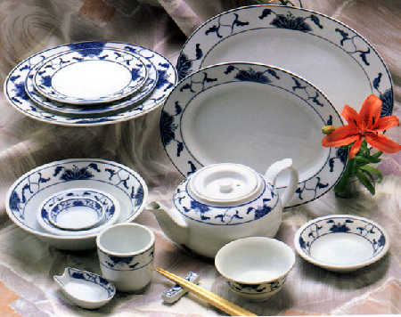
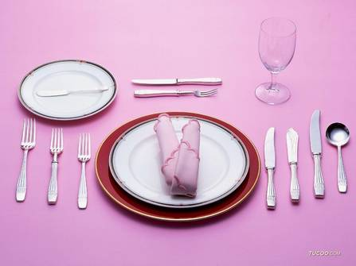
How much do you know about table manners?

Slide 4
Reason
China:
Breaking certain rules can reflect poorly on your parents—they should have taught you better.(子不教，父之过)
Western:
Demonstrating good table manners is thought to bring civilization.
Acceptance
--Certain nation’s value

Slide 5
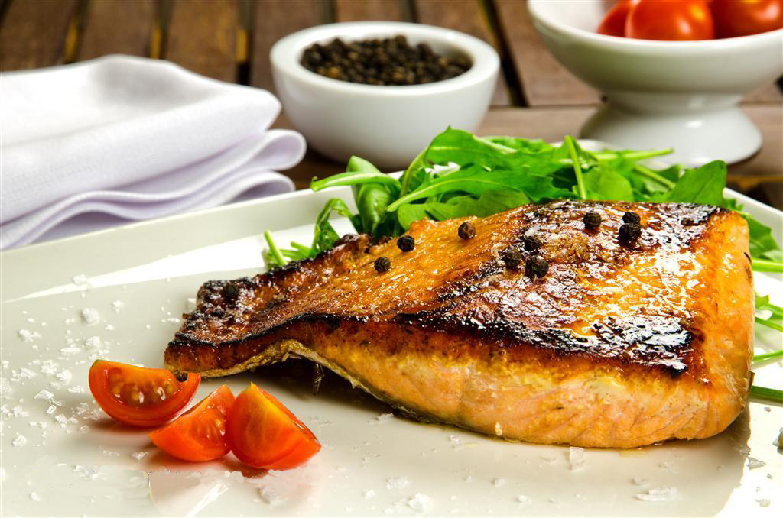
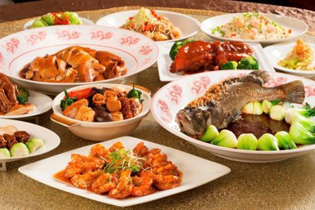
Basic Rule
Formal seating
simply relax, observe
Host seating
lead the way, host the dining
The guest must accord to the host what he likes.(客随主便)
Please help yourself

Slide 6
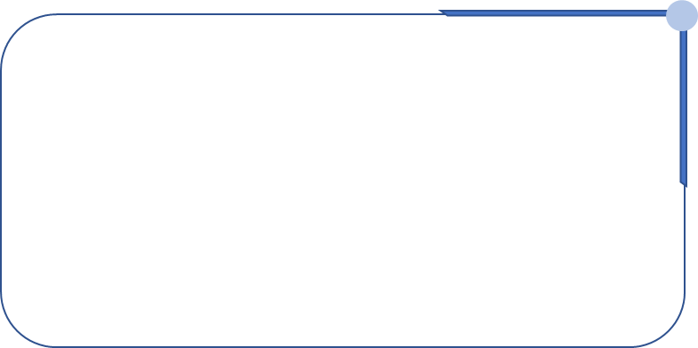
The Setting
host
guest1
guest2
Table
In Chinese culture, the chair facing the entrance (or east, if possible) is known as the "command seat " the Eastern equivalent to "the head of the table ".
--尚左尊东、面朝大门为尊
guest3
guest4
guest5
guest6
companion
Entrance

Slide 7
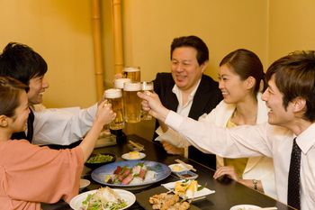
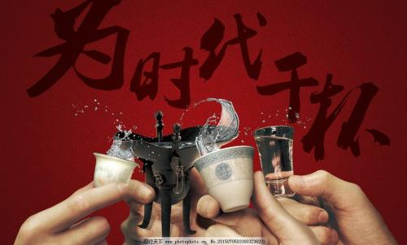
Drinking Etiquette
As with eating, drinking is done communally and follows some loose etiquette.
Someone older
Someone of higher status
Hold your glass slightly lower than theirs to clink
Wait until a toast is given
Drink with the group.
Do not drink alone

Slide 8
Drinking Etiquette
Chinese
More enthusiastic
The emphasis is on people
Drinking vessels are optional
Western
Freer
The emphasis is on alcohol
Drinking vessels are strict

Slide 9

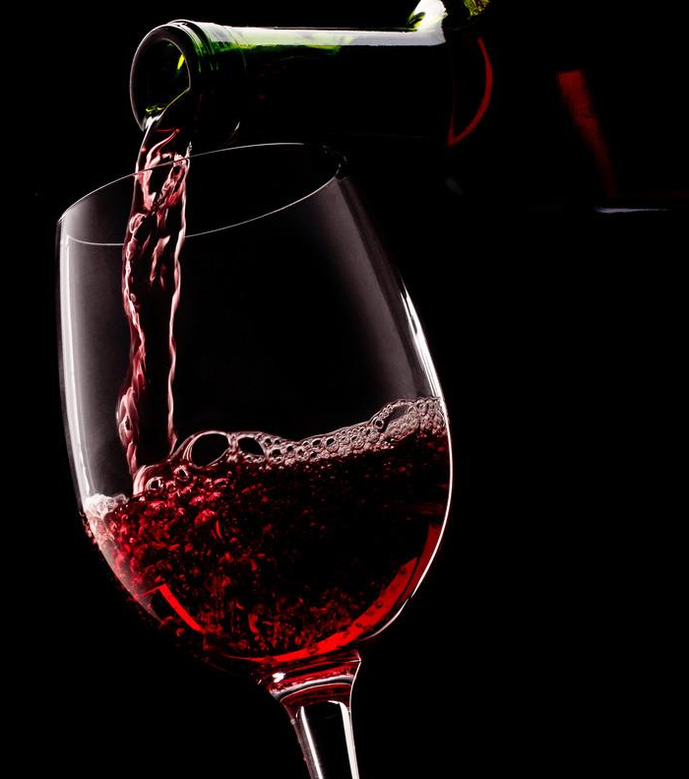
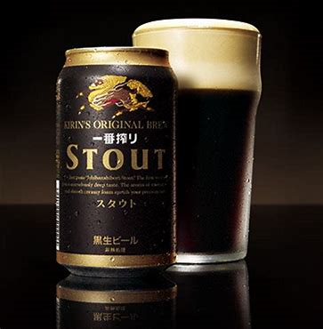
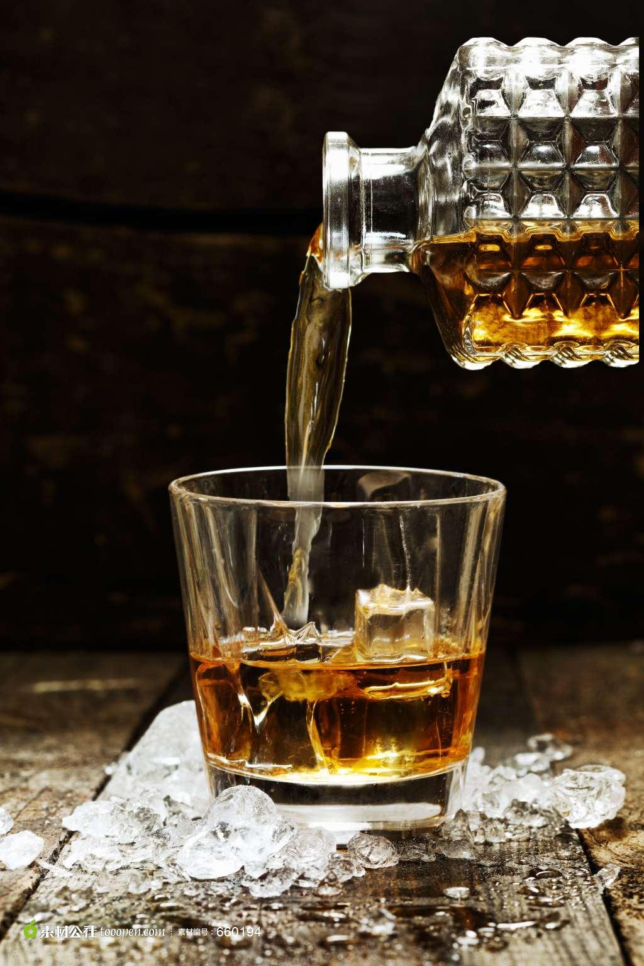
Drinking Etiquette
Cocktail(鸡尾酒)
Wine(葡萄酒)
Beer(啤酒)
Whisky(威士忌酒)

Slide 10
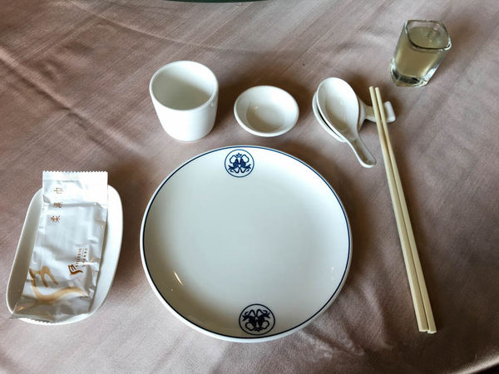
Chinese table wares
Chopsticks:
only clip food
put down the chopsticks when talk with others
never insert the chopsticks into the food vertically
Plate (食碟):
pack food from the public plate
pack the residue of food
take a new one if full

Slide 11
Chinese table wares
Toothpick:
don’t use it in public (use a hand to cover the mouth)
don’t hold it in the mouth
Spoon:
put it on the 食碟 when you don’t use it
Bowl:
don’t lift up the bowl
use cutlery to eat food from it
don’t put it upside down on the table

Slide 12
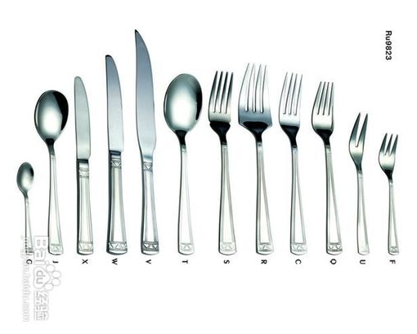
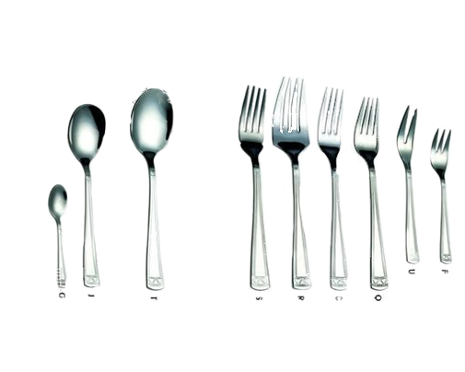
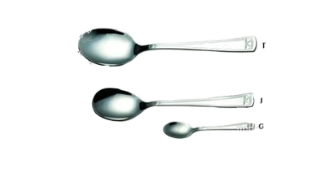
Western table wares
Knife:
steak knife: serration is big, be used to eat steak
dinner knife: serration is small, be used to eat vegetable or fruit
butter knife: carry the butter
Fork:
fruit fork: the smallest one
salad fork: middle
dinner fork: the biggest one
Spoon:
dinner spoon: oval
soup spoon: round
dessert spoon: small

Slide 13
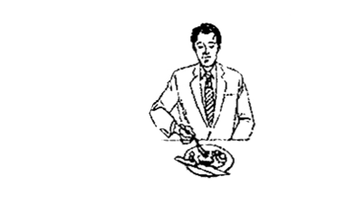
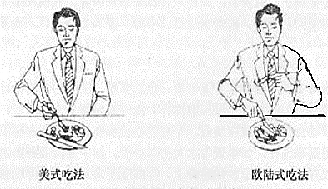
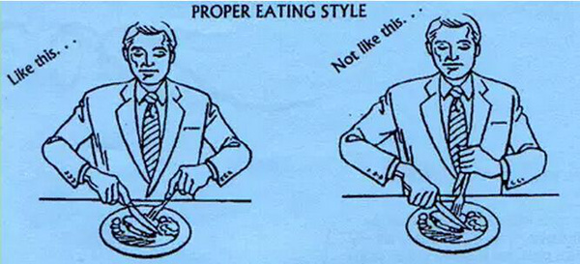
Western table wares
European:
the knife in the right hand, the fork in the left hand
American:
cut vegetable: the knife in the right hand, the fork in the left hand
eat: put the knife on the plate and the fork in the right hand

Slide 14
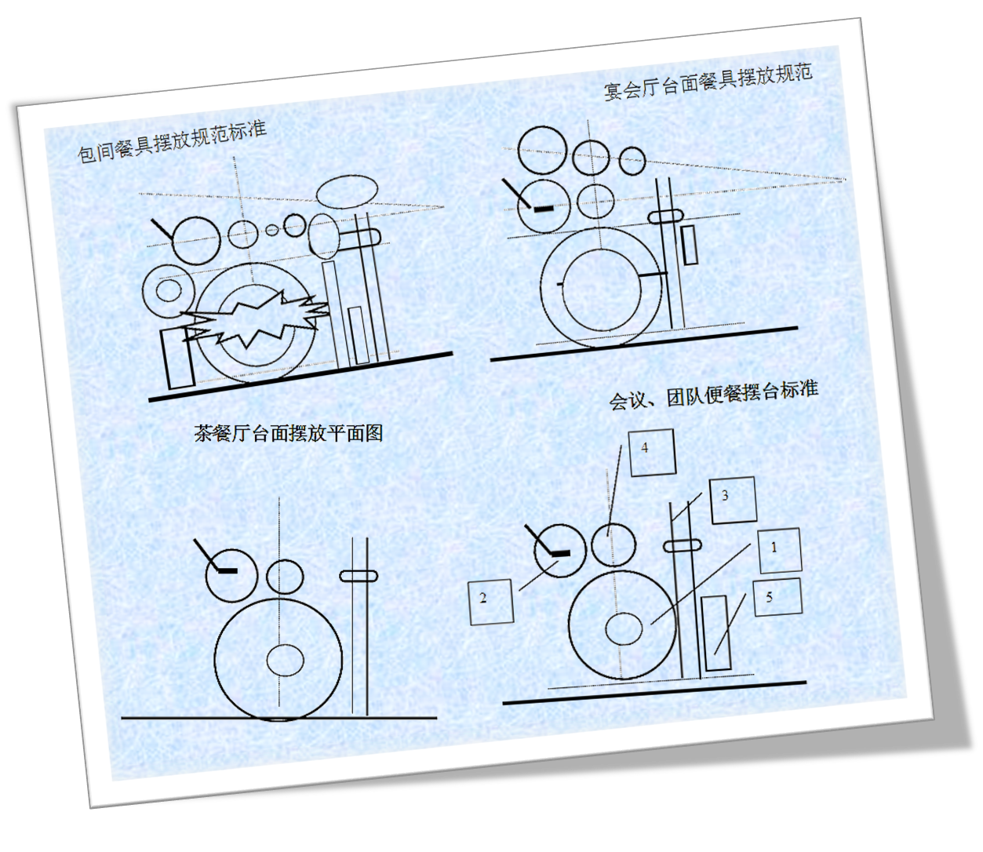
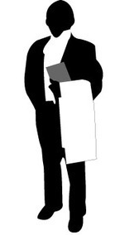
Table wares setting
Chinese:

Slide 15
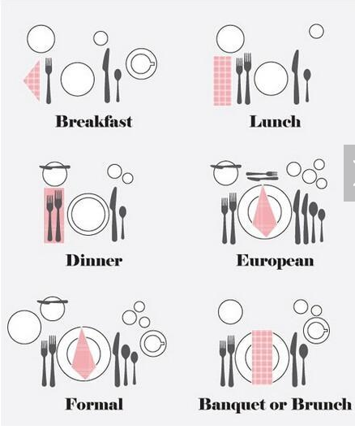
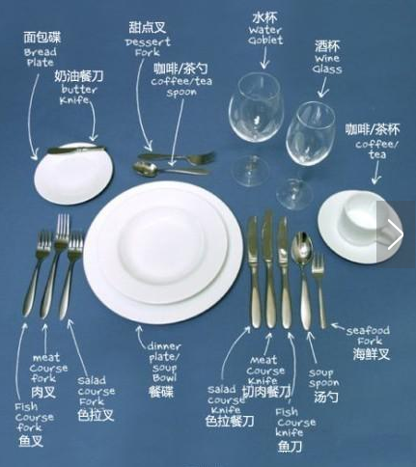
Cutlery setting
Western:

Slide 16
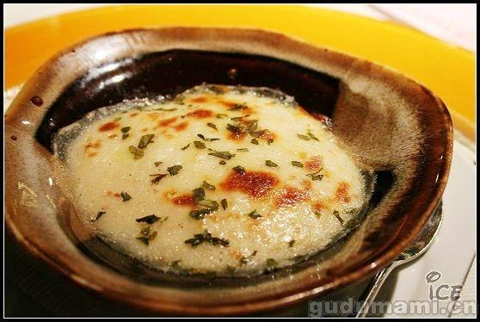
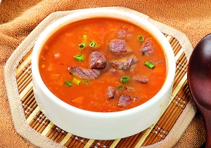
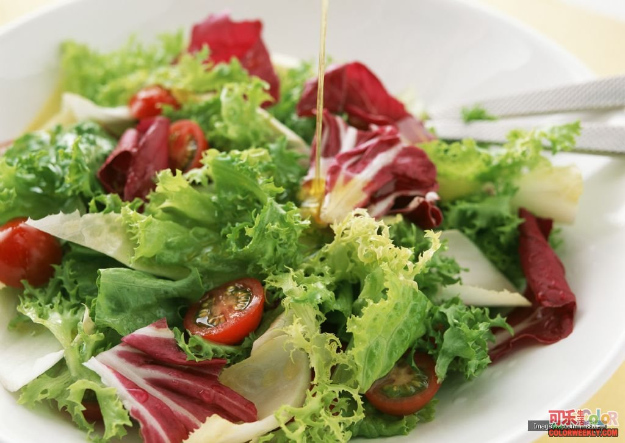
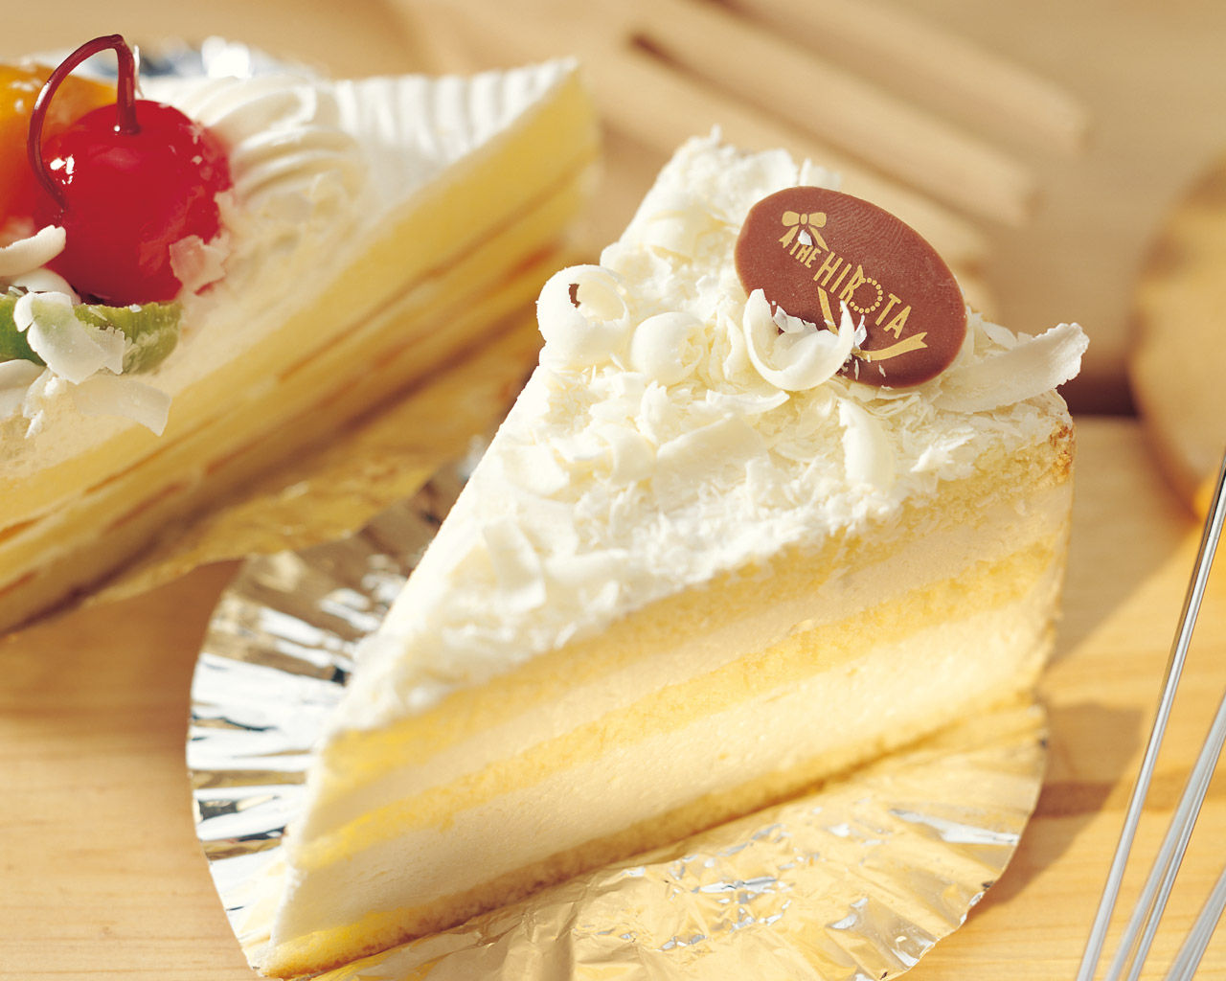
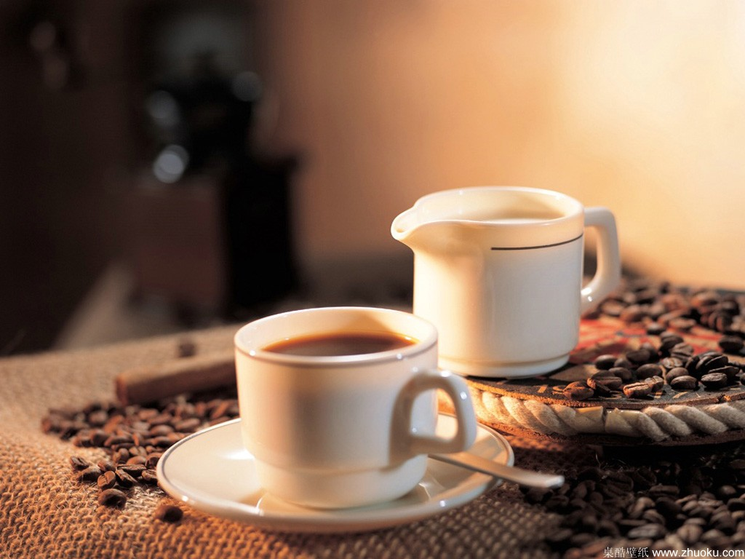
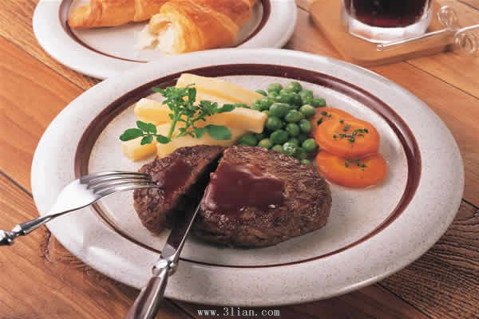
The order of dishes
Dinner start with a small dish
A bowl of soup
Main course
Vegetable salad
Dessert， a cup of tea

Slide 17
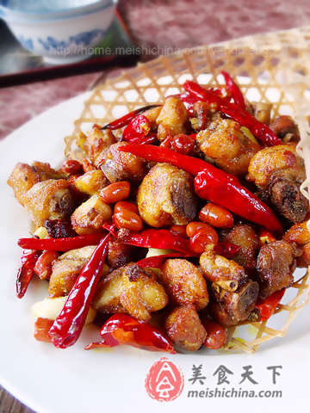
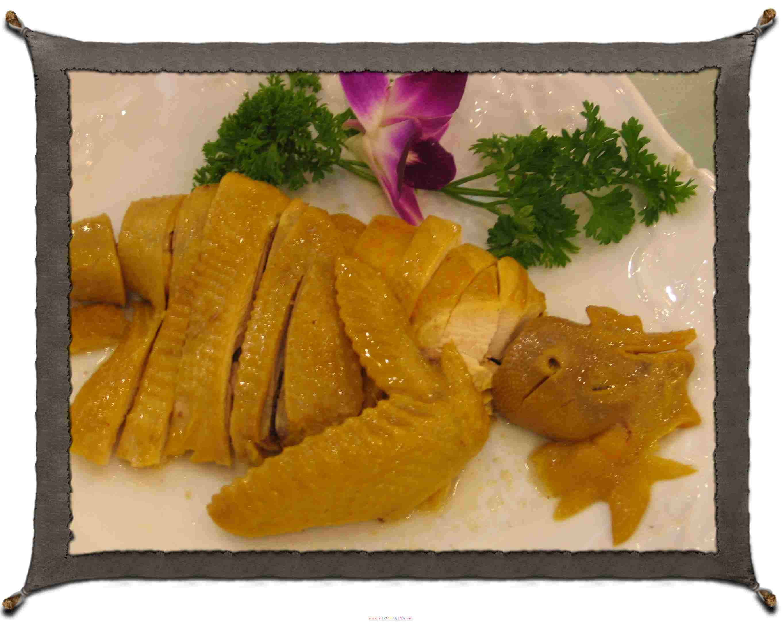
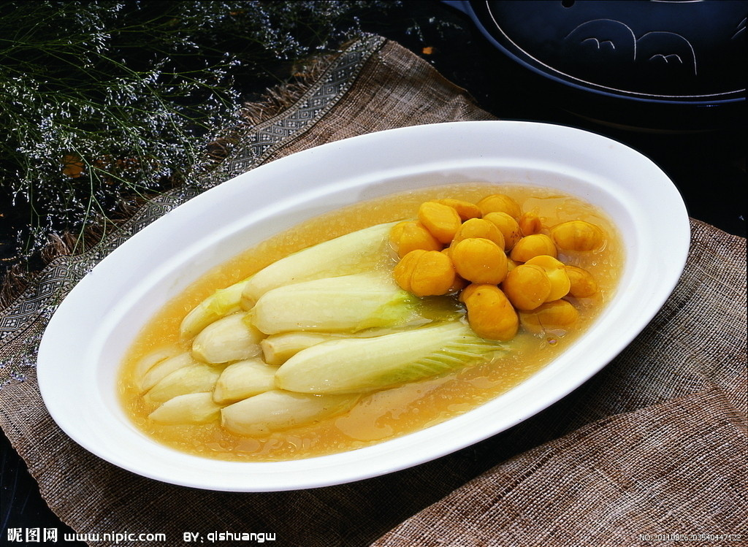
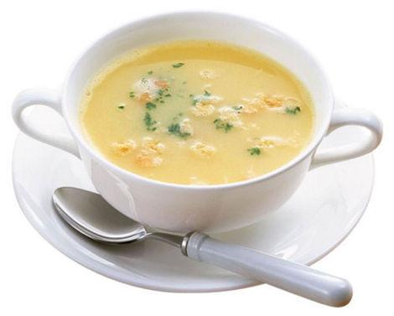
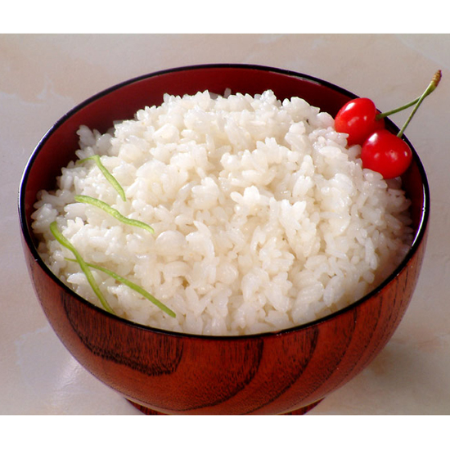
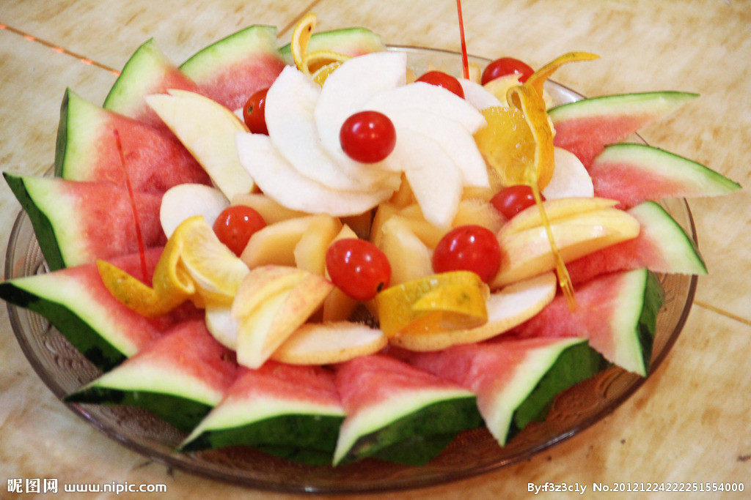
The order of dishes
Main courses
Cold dishes
Soup
Staple food
Staple food last

Slide 18
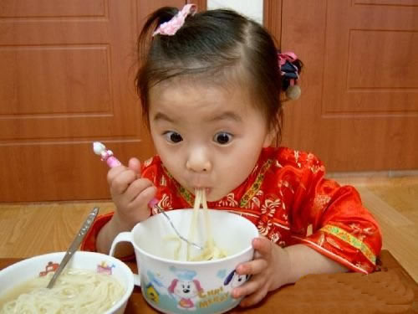
Some interesting manners
Helping Yourself and Refusing
Touching tables
Making noise

Slide 19
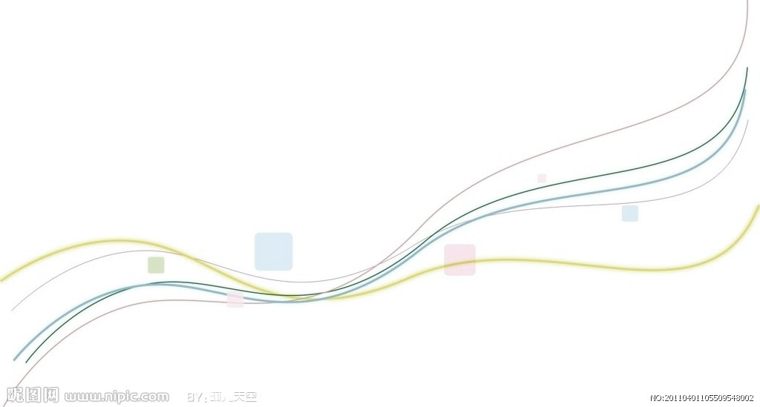
Summary
•Reflection of a kind of culture
•Learning about dining manners is important
•Protect our dining manners

Slide 20
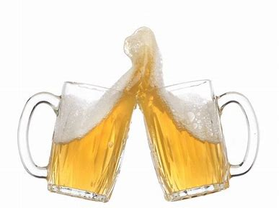
Thank you !

